Slide 1
Network Programming and Java Sockets

Slide 2
Agenda
Introduction
Elements of Client Server Computing
Networking Basics
Understanding Ports and Sockets
Java Sockets
  Implementing a Server
  Implementing a Client
Sample Examples
Conclusions

Slide 3
Introduction
Internet and WWW have emerged as global ubiquitous media for communication and changing the way we conduct science, engineering, and commerce.
They also changing the way we learn, live, enjoy, communicate, interact, engage, etc. It appears like the modern life activities are getting completely centered around the Internet.

Slide 4


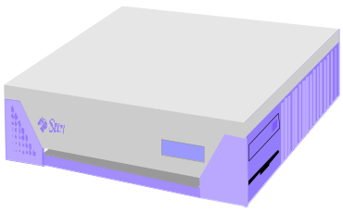
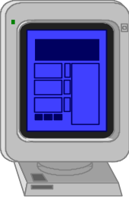

Internet Applications Serving Local and Remote Users
PC client
Internet Server
Local Area Network
PDA

Slide 5
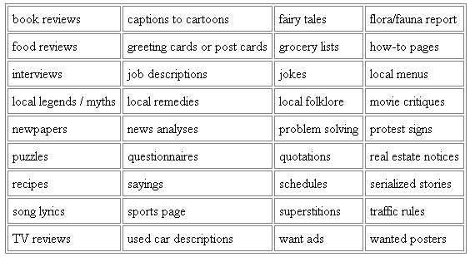
Internet & Web as a delivery Vehicle

Slide 6
Increased demand for Internet applications
To take advantage of opportunities presented by the Internet, businesses are continuously seeking new and innovative ways and means for offering their services via the Internet.
This created a huge demand for software designers with skills to create new Internet-enabled applications or migrate existing/legacy applications on the Internet platform.
Object-oriented Java technologies—Sockets, threads, RMI, clustering, Web services-- have emerged as leading solutions for creating portable, efficient, and maintainable large and complex Internet applications.

Slide 7
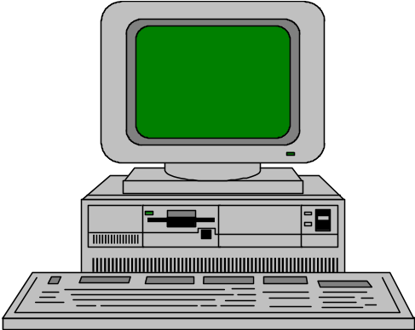

Elements of C-S Computing
a client, a server, and network
Request
Client
Server
Network
Result
Client machine
Server machine

Slide 8
Networking Basics
Applications Layer
  Standard apps
    HTTP
    FTP
    Telnet
  User apps
Transport Layer
  TCP
  UDP
  Programming Interface:
    Sockets
Network Layer
  IP
Link Layer
  Device drivers
TCP/IP Stack
Application
(http,ftp,telnet,…)
Transport
(TCP, UDP,..)
Network
(IP,..)
Link
(device driver,..)

Slide 9
Networking Basics
TCP (Transport Control Protocol) is a connection-oriented protocol that provides a reliable flow of data between two computers.
Example applications:
  HTTP
  FTP
  Telnet
TCP/IP Stack
Application
(http,ftp,telnet,…)
Transport
(TCP, UDP,..)
Network
(IP,..)
Link
(device driver,..)

Slide 10
Networking Basics
UDP (User Datagram Protocol) is a protocol that sends independent packets of data, called datagrams, from one computer to another with no guarantees about arrival.
Example applications:
  Clock server
  Ping
TCP/IP Stack
Application
(http,ftp,telnet,…)
Transport
(TCP, UDP,..)
Network
(IP,..)
Link
(device driver,..)

Slide 11
Understanding Ports
The TCP and UDP protocols use ports to map incoming data to a particular process running on a computer.
server
P
o
r
t
TCP
Client
app
app
app
app
port
port
port
port
TCP or UDP
Packet
Data
port#
data

Slide 12
Understanding Ports
Port is represented by a positive (16-bit) integer value
Some ports have been reserved to support common/well known services:
  ftp 21/tcp
  telnet 23/tcp
  smtp 25/tcp
  login 513/tcp
User level process/services generally use port number value >= 1024

Slide 13
Sockets
Sockets provide an interface for programming networks at the transport layer.
Network communication using Sockets is very much similar to performing file I/O
  In fact, socket handle is treated like file handle.
  The streams used in file I/O operation are also applicable to socket-based I/O
Socket-based communication is programming language independent.
  That means, a socket program written in Java language can also communicate to a program written in Java or non-Java socket program.

Slide 14
Socket Communication
[a]: a client making a connection request to the server
_
A server (program) runs on a specific computer and has a socket that is bound to a specific port. The server waits and listens to the socket for a client to make a connection request.
server
Connection request
port
Client

Slide 15
Socket Communication
[b]: session established with temporary ports used for two way communication.
If everything goes well, the server accepts the connection. Upon acceptance, the server gets a new socket bounds to a different port. It needs a new socket (consequently a different port number) so that it can continue to listen to the original socket for connection requests while serving the connected client.
server
port
port
Client
port
Connection

Slide 16
Sockets and Java Socket Classes
A socket is an endpoint of a two-way communication link between two programs running on the network.
A socket is bound to a port number so that the TCP layer can identify the application that data destined to be sent.
Java’s .net package provides two classes:
  Socket – for implementing a client
  ServerSocket – for implementing a server

Slide 17
Java Sockets
ServerSocket(1254)
server
Output/write stream
Client
Input/read stream
Socket(“128.250.25.158”, 1254)
It can be host_name like “mandroo.cs.mu.oz.au”

Slide 18
Implementing a Server
1. Open the Server Socket:
ServerSocket server;
DataOutputStream os;
DataInputStream is;
server = new ServerSocket( PORT );
2. Wait for the Client Request:
Socket client = server.accept();
3. Create I/O streams for communicating to the client
is = new DataInputStream( client.getInputStream() );
os = new DataOutputStream( client.getOutputStream() );
4. Perform communication with client
Receive from client: String line = is.readLine();
Send to client: os.writeBytes("Hello\n");
5. Close sockets: client.close();
For multithreaded server:
while(true) {
i. wait for client requests (step 2 above)
ii. create a thread with “client” socket as parameter (the thread creates streams (as in step (3) and does communication as stated in (4). Remove thread once service is provided.
}

Slide 19
Implementing a Client
1. Create a Socket Object:
client = new Socket( server, port_id );
2. Create I/O streams for communicating with the server.
is = new DataInputStream(client.getInputStream() );
os = new DataOutputStream( client.getOutputStream() );
3. Perform I/O or communication with the server:
  Receive data from the server:
String line = is.readLine();
  Send data to the server:
os.writeBytes("Hello\n");
4. Close the socket when done:
client.close();

Slide 20
A simple server (simplified code)
// SimpleServer.java: a simple server program
import java.net.*;
import java.io.*;
public class SimpleServer {
public static void main(String args[]) throws IOException {
// Register service on port 1254
ServerSocket s = new ServerSocket(1254);
Socket s1=s.accept(); // Wait and accept a connection
// Get a communication stream associated with the socket
OutputStream s1out = s1.getOutputStream();
DataOutputStream dos = new DataOutputStream (s1out);
// Send a string!
dos.writeUTF("Hi there");
// Close the connection, but not the server socket
dos.close();
s1out.close();
s1.close();
}
}

Slide 21
A simple client (simplified code)
// SimpleClient.java: a simple client program
import java.net.*;
import java.io.*;
public class SimpleClient {
public static void main(String args[]) throws IOException {
// Open your connection to a server, at port 1254
Socket s1 = new Socket("mundroo.cs.mu.oz.au",1254);
// Get an input file handle from the socket and read the input
InputStream s1In = s1.getInputStream();
DataInputStream dis = new DataInputStream(s1In);
String st = new String (dis.readUTF());
System.out.println(st);
// When done, just close the connection and exit
dis.close();
s1In.close();
s1.close();
}
}

Slide 22
Run
Run Server on mundroo.cs.mu.oz.au
  [raj@mundroo] java SimpleServer &
Run Client on any machine (including mundroo):
  [raj@mundroo] java SimpleClient
  Hi there
If you run client when server is not up:
  [raj@mundroo] sockets [1:147] java SimpleClient
  Exception in thread "main" java.net.ConnectException: Connection refused
  at java.net.PlainSocketImpl.socketConnect(Native Method)
  at java.net.PlainSocketImpl.doConnect(PlainSocketImpl.java:320)
  at java.net.PlainSocketImpl.connectToAddress(PlainSocketImpl.java:133)
  at java.net.PlainSocketImpl.connect(PlainSocketImpl.java:120)
  at java.net.Socket.<init>(Socket.java:273)
  at java.net.Socket.<init>(Socket.java:100)
  at SimpleClient.main(SimpleClient.java:6)

Slide 23
Socket Exceptions
try {
Socket client = new Socket(host, port); handleConnection(client);
}
catch(UnknownHostException uhe) { System.out.println("Unknown host: " + host); uhe.printStackTrace();
}
catch(IOException ioe) {
System.out.println("IOException: " + ioe); ioe.printStackTrace();
}

Slide 24
ServerSocket & Exceptions
public ServerSocket(int port) throws IOException
  Creates a server socket on a specified port.
  A port of 0 creates a socket on any free port. You can use getLocalPort() to identify the (assigned) port on which this socket is listening.
  The maximum queue length for incoming connection indications (a request to connect) is set to 50. If a connection indication arrives when the queue is full, the connection is refused.
Throws:
  IOException - if an I/O error occurs when opening the socket.
  SecurityException - if a security manager exists and its checkListen method doesn't allow the operation.

Slide 25
Server in Loop: Always up
// SimpleServerLoop.java: a simple server program that runs forever in a single thead
import java.net.*;
import java.io.*;
public class SimpleServerLoop {
public static void main(String args[]) throws IOException {
// Register service on port 1234
ServerSocket s = new ServerSocket(1234);
while(true)
{
Socket s1=s.accept(); // Wait and accept a connection
// Get a communication stream associated with the socket
OutputStream s1out = s1.getOutputStream();
DataOutputStream dos = new DataOutputStream (s1out);
// Send a string!
dos.writeUTF("Hi there");
// Close the connection, but not the server socket
dos.close();
s1out.close();
s1.close();
}
}
}

Slide 26
Multithreaded Server: For Serving Multiple Clients Concurrently
Client 1 Process
Server Process
Server
Threads
Internet
Client 2 Process

Slide 27
Conclusion
Programming client/server applications in Java is fun and challenging.
Programming socket programming in Java is much easier than doing it in other languages such as C.
Keywords:
  Clients, servers, TCP/IP, port number, sockets, Java sockets

Slide 28
server
Connection request
port
Client
[a]: a client making a connection request to the server
server
port
port
Client
port
Connection
[b]: session established with temporary ports used for two way communication.

